Slide 1
DevOps Enterprise Summit Delivering DevOps Business Metrics That Matter Stephen Elliot, IDC Vice President

Slide 2
Agenda
Technology and business metrics that matter
DevOps communications with the business
The role of security and compliance teams in DevOps
Notes:
What we will discuss: Quantified peer driven perspective. More than opinion.

Slide 3
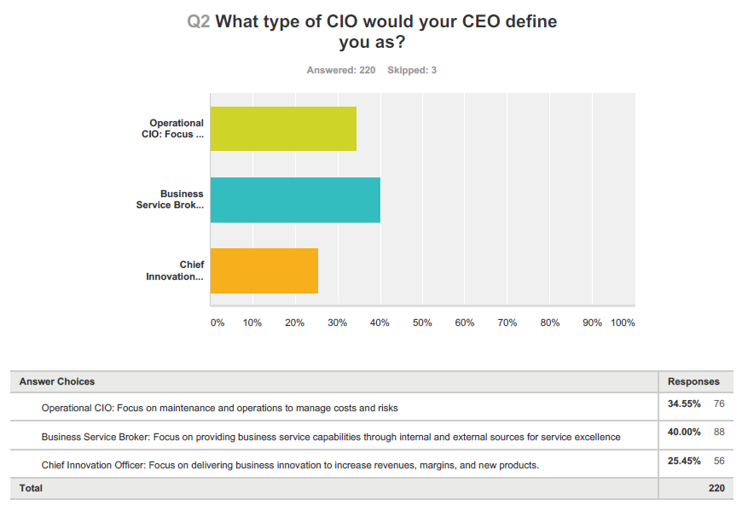
How CEOs View CIOs Today
Source: IDC 2015 CIO Sentiment Research
Notes:
What do people want?
Metrics change depending on who you are talking too, and what they need to achieve. What’s your executive manager being judged on?

Slide 4
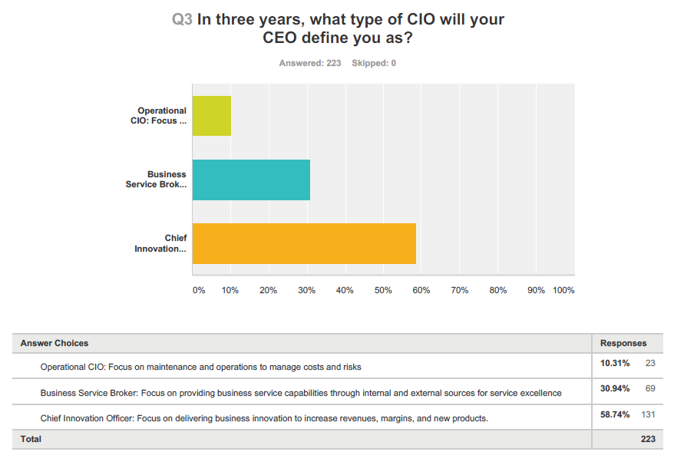
How CEOs View CIOs In Three Years
Source: IDC 2015 CIO Sentiment Research
Notes:
What do people want? Metrics change depending on who you are talking to, and what they need to achieve.

Slide 5
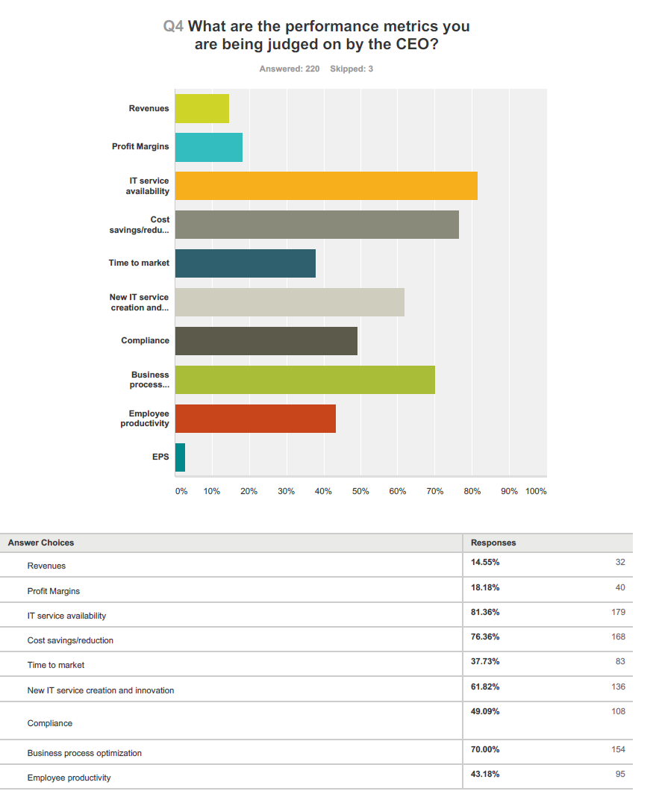
CIO Metrics
Source: IDC 2015
CIO Sentiment Research
Notes:
Understand what your manager and the executive team is paid on.

Slide 6
DevOps Metrics that Matter
Technology Metrics
Deployment frequency
Lead time for changes
Change error rates
Failure rates
Lines of code
Availability
Recovery time
Job satisfaction
Business Metrics
Revenue & Profit
Avoided costs
Customer feedback
Cash flow
Time to market
ROI & NPV
Customer satisfaction
Renewal rates
Cost per service/unit
Value Metrics
Productivity
Quality
Opex
Capex
Notes:
Metrics that matter. How to communicate to whom. Making the business case. It’s about value, not cost savings. You want to keep the money, not shrink the budget. Reinvest the savings.

Slide 7
How to Communicate DevOps Value
Productivity: Speed, velocity and how much faster the team is executing through
faster code development, impact analysis, build and test automation, configuration
Automation, and time to market.
Quality: Improved availability, deeper requirements analysis, early business stakeholder
support and involvement, security and compliance risk reduction, identifying issues earlier
through continuous testing and integration.
Operating Expense: Cost avoidance/optimization, doing more with what you have, fail fast
and fail cheap, cost modeling and allocation/Bill of IT
Capital Expense: Improved utilization, Cloud-based systems, convergence
Notes:
Talking to the business in business terms.

Slide 8
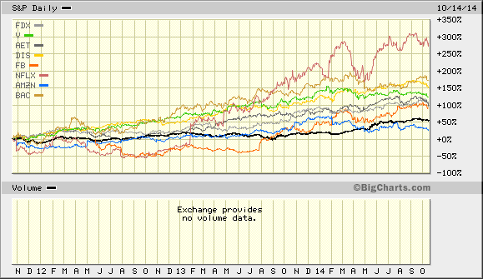
3 Year S&P DevOps Comparison
Source: Biigcharts

Slide 9
Why Projects Fail: The Business Management Chasm
Over the past year, what percentage of your current projects have failed to meet your success criteria?
19% (n=84)
Why?
Poor requirements gathering/scope creep: 23%
Lack of resources (staff and budget): 21%
Changed business priorities: 19%
Lack of business stakeholder ownership: 16%
Testing delays: 10%
User requirements change: 10%
Vendor performance: 1%
35%
Source: IDC 2015 CIO Sentiment Research
Notes:
Business executives need to step up and improve their technology IQ.

Slide 10
Global 1000 DevOps Expectations within 2 Years
Average number of application deployments will double
More than 20% faster time to market expected from DevOps led projects
50% of Global 1000 will have a dedicated DevOps (CoE) team

Slide 11
DevOps CoE or Team Impact
If companies have a DevOps team today, there are five major impact areas:
Operations: new tools and accelerated automated deployments (configuration, asset)
Domain expertise collaboration/empathy increases
Speed of success and the acceleration of IT project success goes up
Decreases “Shadow or Stealth” IT
Allocation-based cost models for services

Slide 12
Role of Security and Compliance Teams
Today, most have “Ad-Hoc” involvement in DevOps practices
However, the future holds the following:
Earlier involvement with auditors, compliance teams, and security teams
DevOps teams will “meet the pre-existing security requirements”
Communicate with the “right language” of the audience
These costs get rolled up in the “Cost per Service”
API wrappers and layer incorporate security and compliance needs

Slide 13
Request for Help
Here's what I'd like help on:
DevOps survey: Please go to the link below:
https://www.surveymonkey.com/r/WDX8B3N
How to move large legacy infrastructure into a DevOps model
(including mainframe)
Is this the next TQM iteration?
How ITIL adjusts to DevOps?

Slide 14
Thank You
Stephen Elliot
IDC
Vice President
Cloud and IT Infrastructure
selliot@idc.com
617-285-4169

